Slide 1
Sales Performance & Forecasting – Market Research
1. Industry Overview
3. KPI Mapping
2. Industry KPIs
4. Case Study

Slide 2

Home Page
Customer Segmentation and Customer Lifetime Value (CLV) Prediction: Driving Data-Driven Sales Performance
In today's rapidly changing business environment, data analytics has become a central competitive advantage. According to Statista, the global customer analytics market is projected to exceed $24 billion by 2030, emphasizing the rising importance of personalization and data-driven decision-making. Modern organizations have realized that acquiring customers is not enough — understanding them is what truly drives sustainable growth.

Slide 3
Home Page
Understanding Customer Segmentation
Customer segmentation is the process of dividing customers into meaningful groups based on shared characteristics or behaviors. In the context of the Superstore Sales Dataset, segmentation can be implemented using fields such as Segment, Region, Category, and Customer ID. For example, customers can be classified as Consumer, Corporate, or Home Office, with each group demonstrating unique needs and purchasing patterns.
Demographic
Geographic
Psychographic
Age, gender, income
City, region, or country
Lifestyle, interests, and values
Behavioral
Technographic
Purchase frequency, brand loyalty, discount sensitivity
Devices or digital habits
By segmenting customers effectively, businesses gain deeper insights into their audience and can develop tailored strategies for communication and sales.

Slide 4





Why Segmentation Matters
Segmentation is valuable because it enables personalization. Sending one marketing message to every customer leads to low engagement and wasted resources. By applying segmentation, companies can deliver messages that resonate with specific audiences. For example, in the Superstore dataset, Corporate clients might prefer bulk orders with minimal discounts, whereas Consumer customers may respond better to promotional campaigns or seasonal offers.
Increases customer engagement and improves conversion rates
Fosters brand loyalty through targeted communication
Identifies which customer groups generate the highest profit
Reveals that a small segment of loyal customers contributes disproportionately to overall revenue
Home Page

Slide 5

What Is Customer Lifetime Value (CLV)?
While segmentation explains who the customers are, Customer Lifetime Value (CLV) quantifies how valuable they are over time. CLV is the total revenue that a customer is expected to generate during their relationship with a business. For instance, one customer might make a single $150 purchase, while another might spend $30 monthly for three years, generating $1,080 in total.
The CLV Formula:
CLV = (Average Purchase Value) × (Purchase Frequency per Year) × (Customer Lifespan in Years)
This equation can be refined with additional factors such as profit margins, discount rates, and churn probabilities. Understanding CLV helps businesses identify high-value customers and focus on nurturing long-term relationships rather than chasing one-time transactions.

Slide 6

Home Page
The Importance of Predicting CLV
Predicting CLV allows companies to make strategic decisions about customer acquisition, retention, and marketing investments. It answers critical business questions such as: Who are our most valuable customers? How much can we afford to spend to acquire them? Which customers are likely to leave, and how can we retain them?
In this project, Python in Google Colab will be used to calculate CLV from the Superstore dataset, leveraging features like purchase frequency, total sales, and profit contribution. By identifying high-CLV customers, businesses can prioritize retention programs, optimize their marketing spend, and allocate resources to segments that drive the most revenue. This predictive capability transforms raw transactional data into actionable business insight.

Slide 7
Home Page
Combining Segmentation and CLV Prediction
Segmentation Identifies
CLV Measures
Different customer groups
Economic value of each group
Shared characteristics and behaviors
Long-term revenue potential
Distinct market opportunities
Profitability contribution
When combined, segmentation and CLV prediction provide a comprehensive understanding of customer behavior. Together, they enable data-driven sales forecasting and performance analysis. For example, if Consumer customers in the West region show high CLV and consistent purchasing behavior, the business can forecast stronger future sales from that group. Conversely, lower-value segments may require promotional adjustments or improved service quality. This integrated approach ensures that businesses focus their efforts on the most profitable areas, leading to higher efficiency and profitability.

Slide 8
Home Page
Analytical Tools Used in the Project
1
2
3
MySQL Workbench
Google Colab (Python)
Power BI
Data extraction, filtering, and aggregation from the Superstore dataset
Data analysis, visualization, and CLV modeling using libraries such as pandas, numpy, and scikit-learn
Visualization layer transforming analytical results into interactive dashboards that display KPIs and insights
This combination of tools provides a complete analytical workflow — from raw data management to predictive modeling and business reporting.

Slide 9




Home Page
Common Tools for Segmentation and CLV in Business
Beyond the tools used in this project, many global organizations rely on specialized platforms for customer analytics.
Google Analytics
Shopify and Klaviyo
Provides behavioral insights for online traffic
Support e-commerce segmentation and automated personalization
HubSpot and Salesforce
Python or R
Offer advanced CRM systems that integrate segmentation, lifecycle management, and CLV tracking
Used by data-driven teams for advanced predictive modeling
Machine learning algorithms continuously improve accuracy as new customer data becomes available. These technologies make it possible for organizations to move from reactive marketing to proactive decision-making based on real-time insights.

Slide 10


Home Page
Challenges and Best Practices
Over-segmentation
Can make marketing campaigns complex and less efficient
Data Quality Issues
Missing, outdated, or inconsistent data often lead to misleading results
Incomplete Understanding
Data cannot fully capture emotional or behavioral nuances
To avoid these pitfalls, it's essential to maintain clean, regularly updated data and start with a small number of meaningful customer segments. The most successful companies are those that balance analytical precision with human understanding, combining analytics with qualitative research like customer surveys or interviews.

Slide 11
Home Page
Real-World Applications and Conclusion
Global brands have demonstrated the power of combining segmentation with CLV analysis:
Amazon
Netflix
Starbucks
Leverages behavioral data to personalize recommendations and forecast customer value
Uses segmentation to predict user engagement and reduce churn through tailored content suggestions
Applies CLV models to reward loyal customers and increase repeat purchases through its rewards program
In the context of our Sales Forecasting and Performance Analysis Project, customer segmentation and CLV prediction will be used to identify high-value customer groups, anticipate future demand, and visualize KPIs through Power BI dashboards. By integrating MySQL, Python, and Power BI, the project connects descriptive analytics (understanding who the customers are) with predictive analytics (forecasting their future behavior). This approach provides a clear, data-driven framework for enhancing decision-making and ensuring sustainable business growth.

Slide 12

Sales Analytics KPIs – Superstore Dataset

Slide 13
Home Page
Introduction
In any retail or sales-focused organization, Key Performance Indicators (KPIs) play a crucial role in measuring business health, tracking growth, and identifying opportunities for improvement. Within the context of the Superstore Dataset, KPIs help analyze sales performance, profitability, customer behavior, and operational efficiency. These metrics enable data-driven decision-making and provide actionable insights to enhance overall business outcomes.

Slide 14
Home Page
Revenue & Profitability KPIs
Total Sales
Total Profit
Profit Margin (%)
Definition: The total revenue generated from all customer orders before deductions or discounts.
Definition: The total earnings after deducting costs from sales.
Definition: The percentage of sales revenue that represents profit.
Formula: Total Sales = SUM(Sales)
Formula: Total Profit = SUM(Profit)
Formula: Profit Margin = (Profit / Sales) × 100
Relevance: Measures the overall scale of business activity. A consistent upward trend indicates market expansion and improved performance.
Relevance: Indicates financial efficiency and helps compare performance across product categories or regions.
Relevance: Evaluates pricing strategy and cost control.
Insight: A high margin reflects efficient pricing, while a low margin may indicate excessive discounts or high operating costs.
Application: Calculated from the Sales column in the dataset, and can be visualized monthly or regionally using Power BI or SQL aggregation.
Additional Revenue Metrics
Average Order Value (AOV): The average amount of money spent per customer order. Formula: AOV = SUM(Sales) / COUNT(DISTINCT Order ID). Helps understand purchasing behavior and supports strategic pricing or bundling.
Sales by Category and Sub-Category: Distribution of total sales across product categories and sub-categories. Formula: SUM(Sales) GROUP BY Category / Sub-Category. Identifies best-performing products and informs inventory or marketing focus.

Slide 15
Home Page
Sales Efficiency KPIs
Sales Growth Rate
Profit by Region
Discount Impact on Sales
Definition: Measures the rate at which sales increase over time.
Definition: Total profit earned within each region.
Definition: Measures the relationship between discounts offered and resulting sales or profits.
Formula: ((Current Period Sales – Previous Period Sales) / Previous Period Sales) × 100
Formula: SUM(Profit) GROUP BY Region
Relevance: Highlights regional strengths and helps allocate resources more effectively.
Formula: Correlation(Sales, Discount)
Relevance: Indicates business momentum and market performance.
Relevance: Determines whether discounts are driving growth or reducing profitability.
Application: Can be calculated monthly or quarterly using Order Date and Sales.
Average Profit per Order
Definition: Average profit generated from each completed order.
Formula: SUM(Profit) / COUNT(DISTINCT Order ID)
Relevance: Useful for evaluating profitability per transaction and comparing across customer segments.

Slide 16
Home Page
Customer Metrics
Number of Unique Customers
Average Sales per Customer
Definition: Total count of distinct customers within a given period.
Definition: The average total sales per customer.
Formula: COUNT(DISTINCT Customer ID)
Formula: SUM(Sales) / COUNT(DISTINCT Customer ID)
Relevance: Indicates the size of the active customer base and supports growth tracking.
Relevance: Helps measure customer value and spending behavior.
Top 10 Customers by Profit
Definition: Identifies customers who contribute the most profit to the business.
Formula: Rank customers by SUM(Profit) DESC
Relevance: Supports targeted retention strategies and personalized marketing campaigns.
Customer Segmentation Performance
Definition: Compares profitability and sales across customer segments (Consumer, Corporate, Home Office).
Formula: SUM(Sales), SUM(Profit) GROUP BY Segment
Relevance: Helps identify the most valuable segments for focused CLV prediction and retention strategies.
Customer Lifetime Value (CLV)
Definition: The projected total revenue from a customer over their relationship with the business.
Formula: CLV = (Average Purchase Value × Purchase Frequency × Lifespan)
Relevance: Guides marketing investments and long-term customer management.

Slide 17
Home Page
Operational & Fulfillment KPIs
1
Average Delivery Time
2
Orders by Ship Mode
Definition: The average number of days between order and shipment.
Definition: Distribution of orders across shipping methods (e.g., Standard, Second Class, Same Day).
Formula: AVG(DATEDIFF(Ship Date, Order Date))
Formula: COUNT(Order ID) GROUP BY Ship Mode
Relevance: Measures operational efficiency and delivery performance.
Relevance: Identifies preferred shipping methods and supports cost optimization.
Application: Derived from Order Date and Ship Date fields in the dataset.
3
Profitability by Ship Mode
4
Sales by Region and State
Definition: Analyzes profit contribution by each shipping type.
Definition: Measures total sales distributed geographically.
Formula: SUM(Sales) GROUP BY Region, State
Formula: SUM(Profit) GROUP BY Ship Mode
Relevance: Provides location-based insights for expansion or performance improvement.
Relevance: Determines whether faster shipping options yield higher or lower margins.

Slide 18
Home Page
Visualization and Insights
All KPIs can be visualized in Power BI dashboards to highlight trends, compare regions, and evaluate performance over time. For instance:
Overview Dashboard
Regional Dashboard
Displays total sales, total profit, and profit margin.
Shows sales and profit by region and state.
Customer Dashboard
Operational Dashboard
Highlights CLV, average sales per customer, and top 10 customers.
Visualizes delivery time, ship mode utilization, and discount performance.
Using MySQL Workbench for data preparation, Python (Google Colab) for calculation and modeling, and Power BI for visualization provides a complete analytical workflow for understanding and optimizing business performance.

Slide 19

Home Page
Conclusion
The KPIs selected from the Superstore Dataset provide a robust foundation for sales performance analysis. They balance revenue tracking, profitability assessment, customer insights, and operational evaluation. By continuously monitoring these indicators, businesses can identify areas of improvement, anticipate sales trends, and strengthen customer relationships through data-driven strategies. In the context of this project, these KPIs will serve as measurable components for forecasting, reporting, and decision-making, ensuring a comprehensive view of sales analytics and performance optimization.

Slide 20
Home Page
KPI Mapping

Slide 21
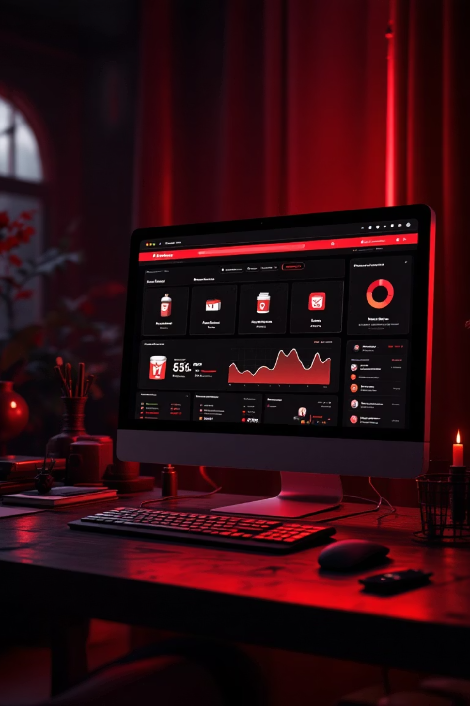
Case Study

Slide 22
Home Page
Mumzworld
The Problem
Lack of clarity into marketing ROI & channel performance
Issues with product availability
Under developed e commerce ecosystem
KPIs
Return on ad spend for marketing channels (ROAS)
Conversion rate % of site visitors who make a purchase
Inventory / out of stock exposures
Action Taken
They implemented Google Analytics 360
Created custom dashboards and reports that moved attention from just revenue to profit‑oriented channel performance. (not just "Which Ad brought clicks" but "Which channel produced highest margin")
Introduced a custom metric to track "out of stock products viewed by users" so marketing spend wouldn't push traffic to unavailable items
Optimized remarketing campaigns "targeting previous site visitors who had not converted" and reallocated budget away from lower performing channels
Outcome
300% ROAS
11% Conversion Increase
Each 1 dollar spent returned 3 dollars in revenue
E commerce conversion rate increased after analytics improvements
128% Remarketing Growth
48-Hour Restocking
Remarketing revenue rose in the first three months
Time to restock top brands reduced from two weeks to fewer than 48 hours

Slide 23
Home Page
Cart.com
The Problem
Lack of Real-Time Analytics
Inconsistent KPIs and Reporting
Scalability Challenges
KPIs
Profit Margin
Sales Growth
Inventory & storage cost reduction
Return on ad spend for marketing channels (ROAS)
Action Taken
Built a unified analytics platform on top of Google Cloud to connect marketing, storefront, inventory and fulfillment data
Real time events handling 40 million events per day processed, enabling live monitoring of shopper behavior, inventory movements, fulfillment performance
Stock out awareness tools linking marketing campaigns to inventory availability so that if an ad drives demand, inventory can be shifted proactively to avoid lost sales or overspending
Improved page load times and scalability to support large volumes of traffic and data
Outcome
20% Margin Increase
15% Cost Reduction
Brands using Cart.com's analytics solution saw up to 20% margin increase
Inventory and storage cost reductions of up to 15% via stock out / storage optimization
5% Sales Improvement
10% ROAS Improvement
Sales improvements up to 5% for clients
ROAS improvements up to 10% for clients

Slide 24
Home Page
Wayfair
The Problem
Frequent incorrect customer delivery addresses
High number of orders subject to carrier surcharges due to address or routing errors
Elevated volume of customer service contacts from address related issues
KPIs
Delivery address accuracy / correct‑address rate
Orders subject to carrier surcharges
Customer service contacts related to address issues
Fraud / chargeback rate
Site performance / load times
Action Taken
Wayfair implemented the Google Maps Platform Address Validation API and Autocomplete in checkout in order to reduce incorrect address entries, improve delivery accuracy and reduce logistics cost
They migrated much of their infrastructure to a hybrid cloud in partnership with Google Cloud Platform to enable scalability (for heavy sale events like "Way Day", Black Friday / Cyber Monday)
For fraud reduction, Wayfair partnered with Riskified (ML based fraud management) to reduce cost of fraud, chargebacks, and false declines, thereby improving overall conversion and profitability
Outcome
10.24% Address Accuracy
33.6% Surcharge Reduction
22.1% Support Contacts
Decrease in incorrect customer addresses
Reduction in orders subject to carrier surcharges
Decrease in customer service contacts for address changes
50% Fraud Cost Reduction
50-60% Chargeback Decline
Reduction in cost of fraud after Riskified collaboration
Decline in chargeback rate after Riskified collaboration

